Slide 1
MTN-028
Screening Visit Procedures

Slide 2
SSP Manual References
Protocol Section 7.2 and Table 10 (Screening)
Section 4: Study Procedures
Section 5: Informed Consent
Section 9: Laboratory Considerations
Section 10: Counseling Considerations

Slide 3
Screening Visit Components
Administrative
IC Administration
Comprehension Assessment
Counseling
HIV Pre-and Post Test
HIV Risk Reduction
Clinical
PTID Assignment
Demographic Information
Eligibility Assessment
Reimbursement Provision
Next Visit Scheduling*
Contraceptive
Protocol Adherence
Medical/Menstrual History Review
Medication History Review
Physical Exam
Pelvic Exam
Referrals or Rx for UTIs/RTIs/STIs*
Provision of Available Results
Locator Information
* If indicated

Slide 4
Screening Visit Components (Cont’d)
Urine
hCG (pregnancy)
Dipstick UA
Blood
CBC with differentials/platelets
HIV-1 Serology
Genital
Urine Culture*
Hepatitis B Surface Antigen
Hepatitis C Antibody
Chemistries (ALT/AST/Creatinine)
Vaginal pH*
KOH Wet Mount for Candidiasis*
Saline Wet Mount for BV*
Rapid Trichomonas Test
NAAT for GC/CT
Pap Test*
Syphilis Serology
Coagulation (INR)
* If clinically indicated
Notes:
More to come on this from the MTN LC…

Slide 5
Informed Consent Tools

Slide 6
Informed Consent Form
Required
Screening
Enrollment
Optional
Long-Term Specimen Storage
Notes:
Talking points:
Informed consent will be obtained at screening and must be obtained before performing any “on-study” procedures.
Note that specimen storage in consent for LONG TERM storage of specimens left over from study samples. All participants consent to the “storage” of per protocol samples for the duration of the study. For participants who do not consent to long term storage, these samples will be destroyed at the end of the study.

Slide 7


Slide 8
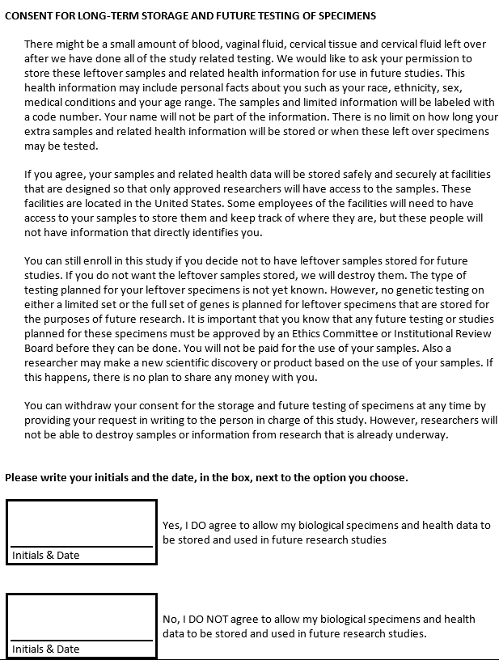

Consent for Long-Term Specimen Storage and Future Testing

Slide 9
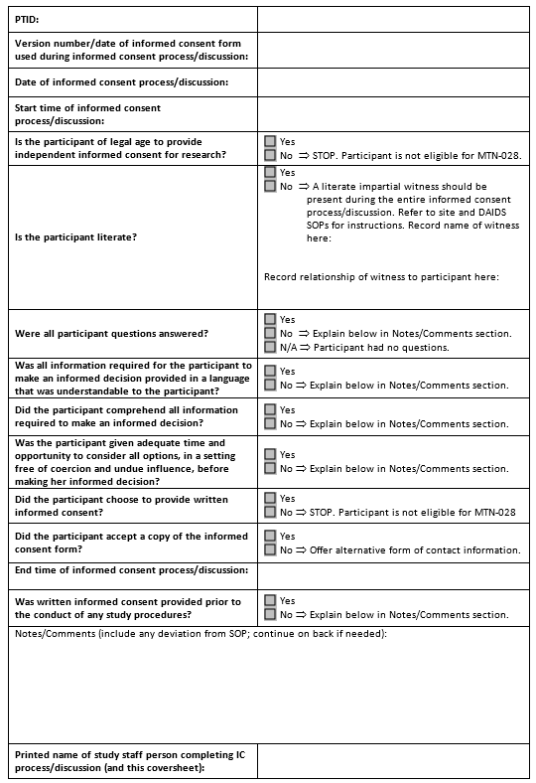
Informed Consent Coversheet
Captures all required elements of IC documentation
Use of a coversheet strongly recommended
Notes:
The DAIDS policy on Requirements for Source Documentation in DAIDS Funded and/or Sponsored Clinical Trials lists detailed requirements and suggestions for documenting the informed consent process. All requirements listed in the DAIDS policy must be met.
In order to also meet some of the suggestions listed in the DAIDS policy, site staff are strongly encouraged to use an Informed Consent Coversheet similar to the sample included on the MTN-028 webpage under Study Implementation Materials.
The first half of the coversheet (items up to and including “Is the participant literate?”) should be completed at the start of the IC session. The remainder should be completed at the end of the informed consent session.
If you chose not to utilize the Informed Consent Coversheet, all elements of each informed consent process must be documented in detail in a signed and dated chart note.

Slide 10
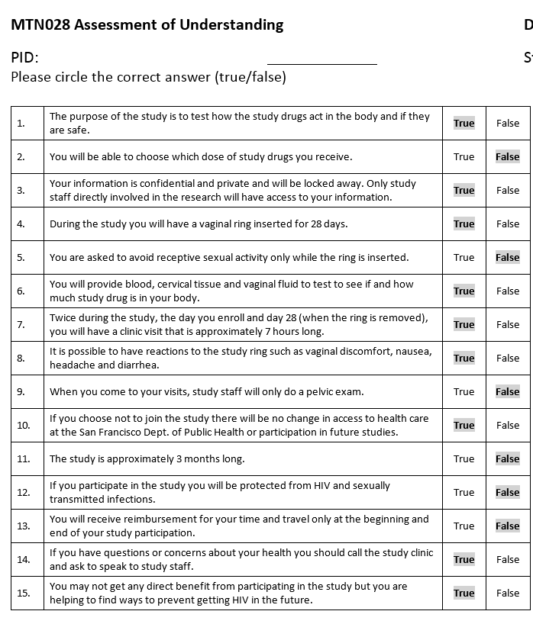
Comprehension Assessment
Administered after IC discussion but before the participant signs the ICF
Assists staff in assessing participant comprehension and ensures participant understanding prior to providing consent for study participation
Notes:
The participant must not be asked to agree to take part in the study, or to sign the informed consent form, until s/he fully understands the information contained in the informed consent, including visit procedures.

Slide 11
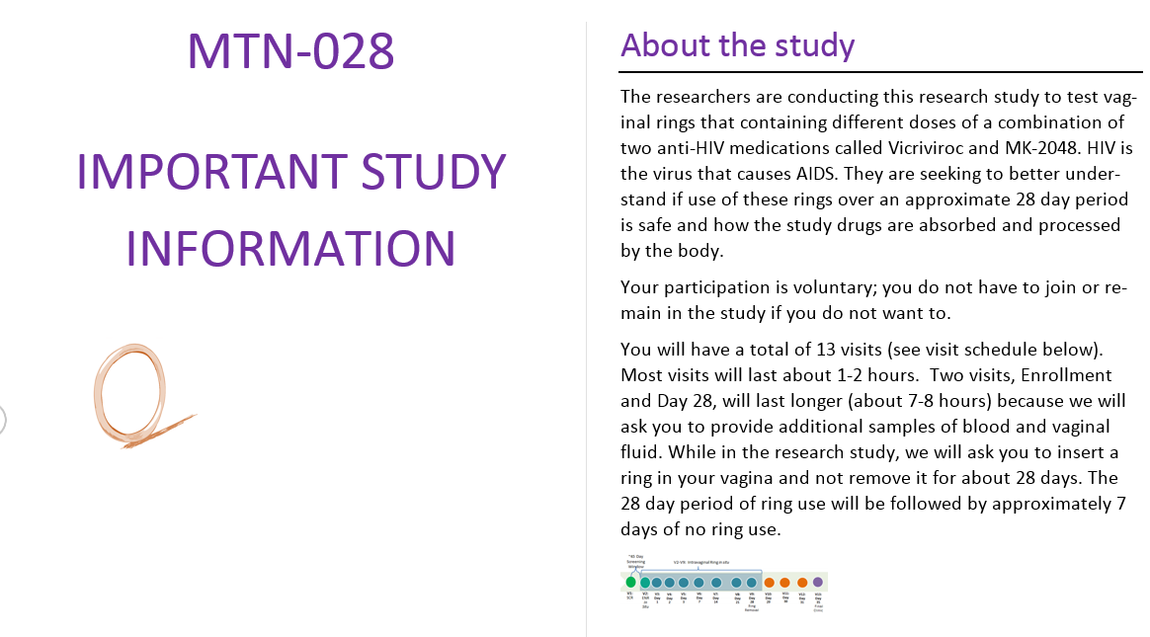
Visual Aids
Sample Vaginal Ring
Information Booklet
Calendar with study visit schedule
Urine specimen cup
Blood collection tubes
IVR Insertion Instructions
Other randomization explanation visual aids (e.g., sack or box containing four items of different colors)

Slide 12
Eligibility Assessment

Slide 13
Eligibility Determination
All eligibility criteria are initially assessed at Screening.
All eligibility criteria are confirmed on the day of Enrollment.
It is the responsibility of the site Investigator of Record (IoR) and other designated staff to ensure that only participants who meet the study eligibility criteria are enrolled in the study.
Notes:
If any participant is found to be ineligible, the management team and PSRT should be immediately informed.

Slide 14
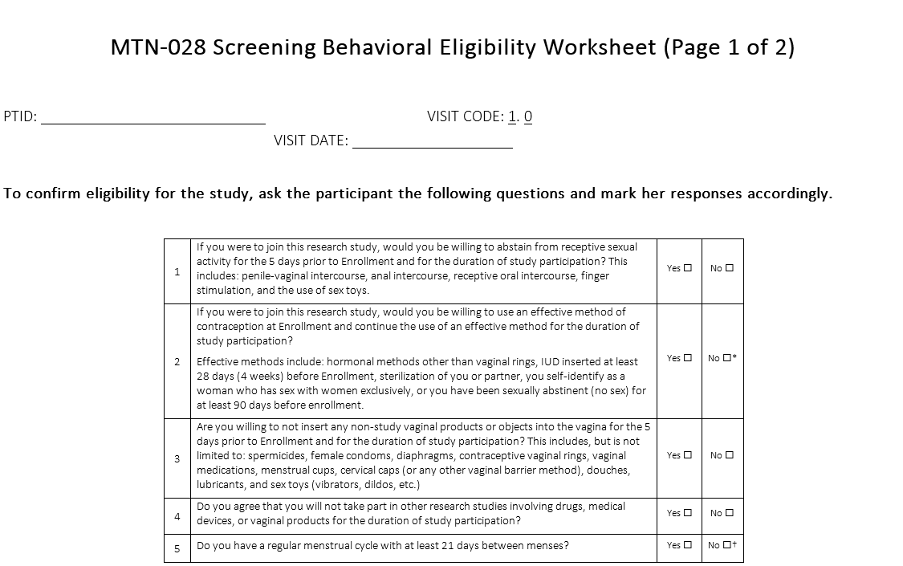
Screening Behavioral Eligibility Worksheet
Recommended source document for assessing eligibility criteria which are based on self-report
Notes:
It is suggested that staff administer this questionnaire early in the screening visit, so that more time-consuming clinical and laboratory evaluations can be avoided if the participant is determined ineligible due to behavioral criteria (unless sites decide to administer clinical and laboratory evaluations regardless of eligibility as a service to the participant).

Slide 15
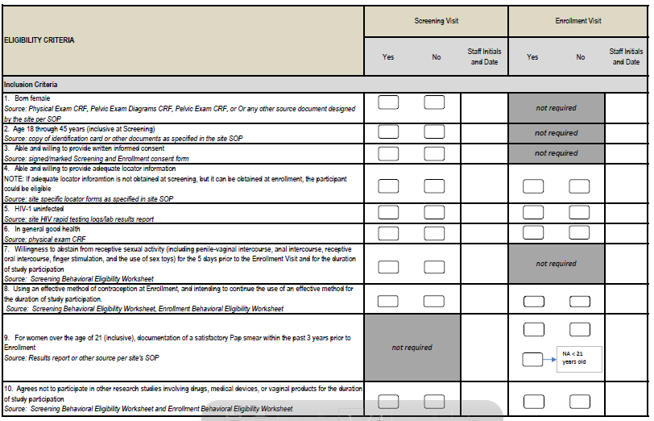
Eligibility Checklist
Documents participant eligibility for all inclusion/exclusion criteria
To be completed at Screening and at Enrollment by designated staff
Initial and date next to each item you completed
Recommended source document for each item is listed in italics for ease of reference

Slide 16
Screening Counseling Tools

Slide 17
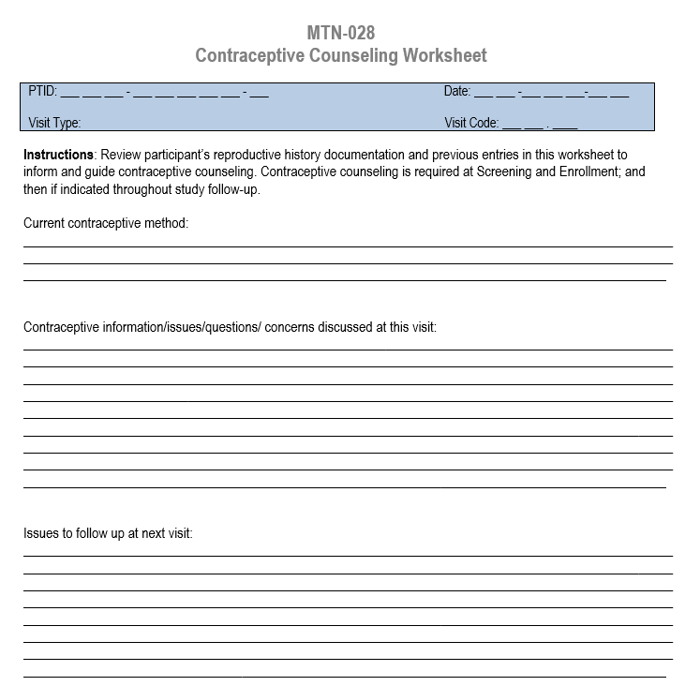
Contraceptive Counseling Worksheet
Assess eligibility criteria related to pregnancy intentions and willingness to use an effective contraceptive method
Focus on explaining which methods are acceptable for study purposes and emphasize that women who cannot commit to use of these methods for the duration of the study should not enroll
Notes:
Required at Screening and Enrollment; done if indicated at all other visits
To be eligible for MTN-028, potential participants must report use of an effective method of contraception at enrollment and intend to use an effective method for the duration of study participation. Per protocol, effective methods include hormonal methods (except for contraceptive IVRs), intrauterine device (IUD) inserted at least 28 days prior to enrollment, engaging in sex with women exclusively, self or partner sterilization, and/or being sexually-abstinent for the past 90 days. For those participants who report sterilization, study staff must verify the sterilization per site eligibility SOPs; the site is encouraged to obtain medical records as part of their verification procedures
Participants must have no intention to become pregnant within the 3 months following screening or enrollment.
Question for sites: Do you offer contraception on site refer participants to non-study providers?

Slide 18
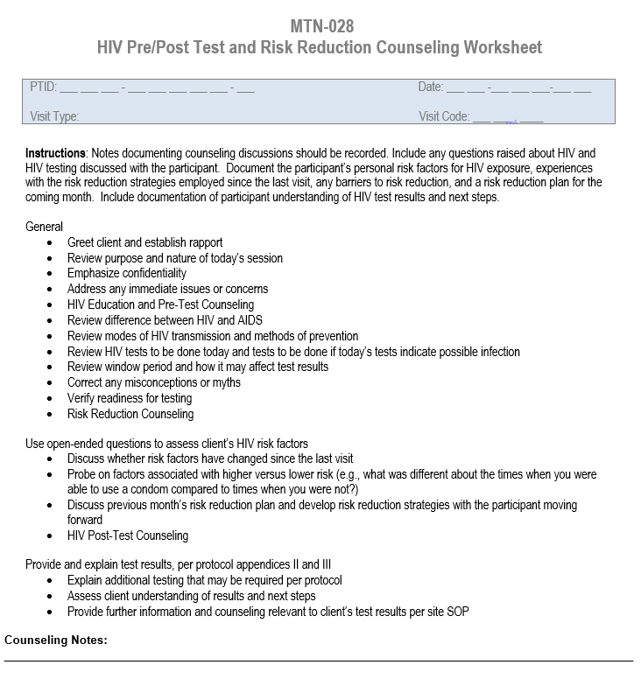
HIV Pre/Post Test and Risk Reduction Counseling Worksheet
Overview of the minimum requirements for HIV testing and counseling sessions
Assess participant knowledge of relevant information, dispel any misconceptions, ensure participant readiness for HIV testing, ensure participant understanding of test results
Guides the participant in identifying risk factors, barriers to risk reduction and developing strategies and action plans to reduce/eliminate risk
Notes:
Risk reduction counseling is required per protocol at the enrollment visit, and should also occur whenever HIV testing is done.
Client-centered approaches should be used when assessing participant risk for HIV infection and providing risk reduction counseling.
Abstinence requirements for the duration of the study may also be emphasized during risk-reduction counseling.
Supported and facilitated by the counselor, the risk reduction plans identified by the participant should reflect and respond to her current risk assessment and should be practical, yet challenge the participant toward risk reduction. For participants whose risk reduction barriers are significant, risk reduction plans may need to be incremental. For participants whose risk reduction barriers change over time (e.g., due to a partner change), risk reduction plans may need to change over time. Importantly, all risk reduction plans should be agreed upon by the participant and should be documented in the participant’s study records, with a copy made available to the participant if she wishes.
At each counseling session, the risk factors and risk reduction plans identified at the previous sessions should be reviewed and discussed with the participant to determine her experience since her last session, was she able to carry out her strategies and plans, and what were the outcomes. Risk reduction plans identified and agreed upon with the participant at the current session should then build on experience since the last session. Additional or alternative strategies may be identified to achieve further risk reduction if current strategies were not successful.
Risk reduction counseling sessions should also offer skills building to the participant when indicated, how to discuss sensitive issues with partners and other influential persons. HIV counseling for partners should always be offered, either as an individual session or as a couple’s session.
Referrals are expected components of risk reduction plans when indicated based on participant needs. When referrals are provided, these should be fully documented in participant study records and should be actively followed up at subsequent counseling sessions to determine whether the participant sought the services to which she was referred, what the outcome of the referral was, and whether additional referrals are needed. All such follow-up should also be fully documented in participant study records.

Slide 19
Protocol Adherence Counseling
Reference the ‘Prohibited Activities and Products’ section of the MTN-028 Important Study Information Booklet available on the MTN-028 webpage (http://www.mtnstopshiv.org/node/6560)
Review the list of prohibited medications, products and practices participants should refrain from engaging in or using during study participation
Document provision of counseling in chart notes and/or visit checklist
Notes:
Participants will be counseled to avoid certain practices prior to enrollment and for the duration of study participation. Key messages related to protocol adherence are incorporated into the Protocol and Product Use Adherence Worksheet (to be covered in detail during the Enrollment presentation).
However, at Screening, participant should also be counseled to avoid using prohibited product and engaging in certain practices. Participants will be asked to refrain from using tampons during the first week of study participation (starting at the enrollment visit) and for 24 hours prior to each clinic visit following enrollment.
Prohibited non-study intravaginal products and other devices include, but are not limited to, spermicides, female condoms, diaphragms, contraceptive intravaginal rings, vaginal medications, menstrual cups, cervical caps, douches, lubricants, and sex toys (e.g., vibrators, dildos, etc.).
Participants are expected to be sexually abstinent for the duration of their trial participation and for 5 days preceding Enrollment, i.e., no receptive intercourse (vaginal, anal, oral and finger simulation).

Slide 20
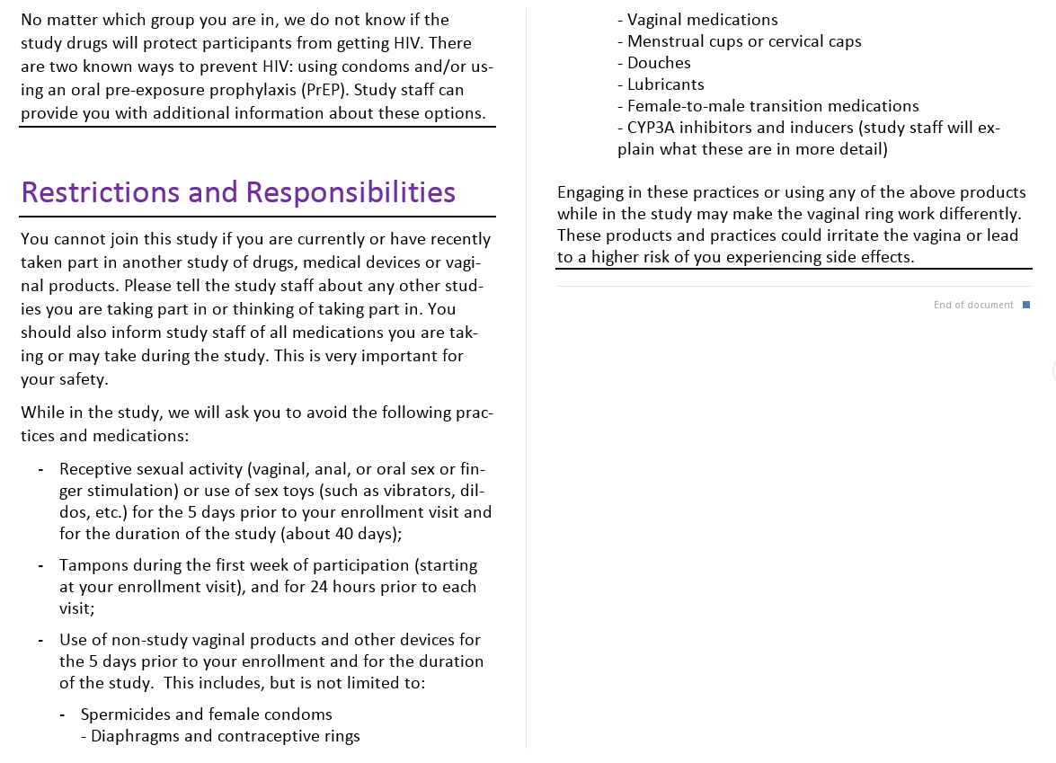
Protocol Adherence Counseling

Slide 21
Other Visit Tools

Slide 22
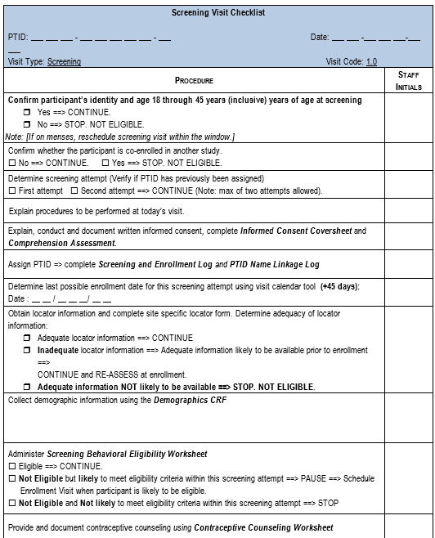
Screening Visit Checklist
Serves to guide proper study procedures as well as to serve as source documentation of procedures performed at study visits
Notes:
Sample visit checklists were created that detail all protocol-specified procedures that must be completed during a given visit. The checklists also specify the data collection forms that must be completed at each visit.
The visit checklists are designed to guide you in proper study procedures as well as to serve as source documentation of procedures performed at study visits. Note, however, that checklists alone may not be sufficient for documenting all procedures. Chart notes may be required to supplement information documented during study visits.
Instructions: Complete staff initials next to procedures completed. Do not initial for other staff members. If other staff members are not available to initial checklist items themselves, initial and date a note on the checklist documenting who completed the procedure, e.g., “done by {name}” or “done by nurse.” If a procedure listed on the checklist is not performed, enter “ND” for “not done” or “NA” for “not applicable” beside the item and record the reason why (if not self-explanatory); initial and date this entry. If any procedures are not conducted on the date recorded above, ensure the date procedure conducted is included in the comments section. Use a new Screening Visit Checklist if a second screening attempt is needed.
The sequence of procedures presented on the visit checklists is a suggested ordering. In consultation with the MTN LOC (FHI 360), it is encouraged that site staff modify the checklists included in this section to maximize the efficiency of site-specific study operations. For screening, the only requirement is that IC be conducted before any per protocol procedures—other ordering is flexible.
This can be source for some procedures, but most procedures require additional documentation elsewhere. Refer to your source doc SOP document; this checklist is a tool for ensuring all the processes documented elsewhere are completed appropriately so staff has a snapshot of what needs to be done/resolved to complete eligibility assessments.

Slide 23
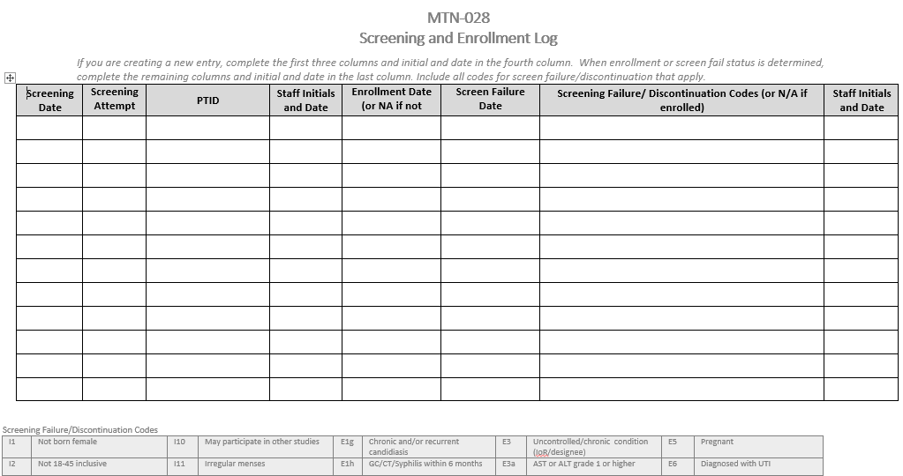
Screening and Enrollment Log
Notes:
A sample screening and enrollment log suitable for use in MTN-028 is available on the MTN website (http://www.mtnstopshiv.org/node/6560).
DAIDS policy requires logs be maintained for every prospective ppt screened. These need to be used in real time and completed as soon as a potential participant completes screening and signs the IC form. If the participant does not provide written IC, s/he should NOT be listed on this log.
Note on the log the column asking for Reason for screening failure/discontinuation- you’ll want to list ALL reasons she fails screening, if there is more than one reason. Codes on the lower part of the Log will help for ease of documentation.
If a participant rescreens, a new row on the log must be completed, using the SAME PTID number previously assigned. The Eligibility Criteria CRF, which was previously completed, would be updated and refaxed to SCHARP.

Slide 24
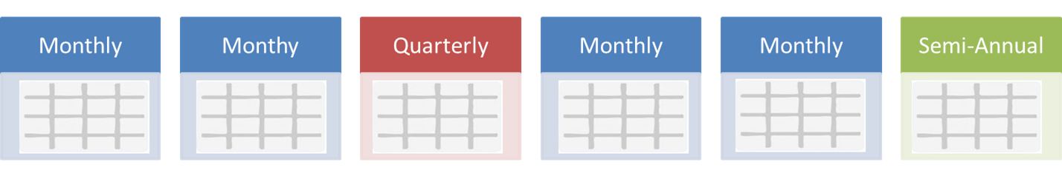
Screening Window
Screening
Enrollment
45 Days
→If needed, screening visit procedures can be completed over multiple visits.
One rescreen allowed per IoR discretion
Notes:
All protocol-specified screening/enrollment procedures must take place up to 45-days prior to enrollment/randomization.
The 45-day period starts as soon as the participant signs the informed consent form, even if no other screening procedures were done on that day.
If needed, screening visit can be conducted over multiple visits.
In cases where the Screening visit is conducted over multiple days, all procedures are considered part of the same screening visit/screening attempt.
The term “screening attempt” is used to describe each time a participant screens for the study (i.e., each time s/he provides written informed consent for participation in the study).
If all screening and enrollment procedures are not completed within 45 days of obtaining written informed consent, the participant must repeat the entire screening process except for PTID assignment.

Slide 25
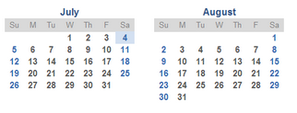
Screening Window
For example, if a participant signs the informed consent on July 1st, the last day for enrollment is August 15th. Since enrollment is considered Day 0, you count backward -45.
To make things easier, Last Day to Enroll Calculator was created so sites can enter the screening date and the calculator will provide the last day of enrollment.

Slide 26
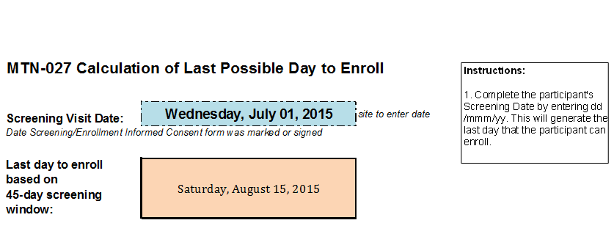
Last Day to Enroll Calculator
Notes:
Excel tool provided by SCHARP which helps to calculate the last date in which a screened participant may enroll.

Slide 27
Required Documentation for Screen Failures
Completed ICF
Reason(s) for ineligibility, with date of determination, as per the completed Eligibility Checklist
Necessary referrals on file (as appropriate) and documentation that any clinically significant abnormalities (labs, etc.) were communicated to the participant (even if referral is not necessary)
All source documentation complete up until the time that ineligibility was determined
Chart notes complete up until the time ineligibility was determined
Indication of what visit procedures were conducted (on visit checklists)
Completed Eligibility Criteria CRF, updated with screen failure reason(s) and faxed to DF/Net
Completed Screening and Enrollment Log with reason for discontinuation
Notes:
Screening procedures should be discontinued when the participant is determined to be ineligible. If the participant is found to be ineligible at the beginning of the screening visit, you may choose to continue with clinical and laboratory evaluations as a service to the participant, per their site SOPs. If a participant screens out due to a clinical condition requiring follow-up, appropriate referrals should be provided to ensure well-being of the participant. Documentation of all referrals should be included in the participant chart. All lab results should be provided and explained to participants within a reasonable timeframe, regardless of eligibility determination. For all screened out participants, the following documentation should be in place:
For all screened out participants, the following documentation should be in place:
Completed ICF
Reason(s) for ineligibility, with date of determination, as per the completed Eligibility Checklist
Necessary referrals on file (as appropriate) and documentation that any clinically significant abnormalities (labs, etc.) were communicated to the participant (even if referral is not necessary). All lab results should be provided to participants within a reasonable timeframe.
All source documentation complete up until the time that ineligibility was determined
Chart notes complete up until the time ineligibility was determined
Indication of what visit procedures were conducted (on visit checklists)
Completed Eligibility Criteria CRF, updated with screen failure reason(s) and faxed to DF/NET
In addition, the Screening and Enrollment Log should be updated with date of discontinuation of screening and reason for screen failure (list item number as appropriate from the Eligibility Checklist).

Slide 28


MTN-028 Screening Visit CRFs

Slide 29
Approach to CRF Training
Focus on purpose/reason for key CRFs
Will try to address questions received during external review of CRFs
Will not go item by item, but will focus on key fields
Will not review form instructions, but will refer to these as needed
Please ask questions!

Slide 30
Screening CRFs
Demographics CRF
Eligibility Criteria CRF
Pre-existing Conditions CRF
Concomitant Medications Log CRF
Physical Exam
Pelvic Exam CRF (+ pelvic exam diagrams form)
Safety Laboratory Results CRF
Notes:
Note that the PX, PE, CM and SLR will be covered will reviewing the clinical and lab CRFs.

Slide 31
Demographics (DEM-1)
Completed once for each participant at Screening Visit
Interviewer-administered
Collects required participant descriptors
  Age
  Race
  Ethnicity
Collects descriptors requested for publications/reports
  Gender
  Highest level education
  Income
Items reflect participant status at Screening only – not updated later unless correction is needed

Slide 32
Pre-existing Conditions Log (PRE)
Will include participant-reported conditions as well as abnormalities captured on:
  Pelvic Exam Diagrams, Pelvic Exam CRFs, (from screening and enrollment)
  Physical Exam CRFs (from screening and enrollment)
  Grade 1 and higher laboratory results on Safety Laboratory Results CRF

Slide 33
Pre-existing Conditions log – con’t
Page number – start with 01, go up as needed
Condition
  Follow guidelines for AE text except do record past surgeries
  Be as descriptive as possible
Onset Date (Month and Year)
  If uncertain, use best estimate; year required
Comments
  Add info on frequency and duration of chronic condition outbreaks; other relevant info for the “snapshot”

Slide 34
Pre-existing Conditions log – con’t
Ongoing at Enrollment?
  Leave blank at screening if ongoing; complete at enrollment
  Chronic/recurrent diagnoses are ongoing
Severity Grade
  Assess per DAIDS Tox Table and FGGT
  Mark “not gradable” if condition is below Grade 1 or resolved at time of report (ex. Cesarean section entry)

Slide 35
Pre-existing Conditions log– con’t
Entries can be added and modified post-enrollment
  Participant may have forgotten to report a symptom
  Perhaps something that was thought to be not relevant is later considered relevant; if so, add to PRE
  May need to collapse signs/symptoms into a diagnosis
  Write a chart note to explain why an entry is being added/modified during follow-up
Document meds taken for PRE on Concomitant Medications Log CRF

Slide 36
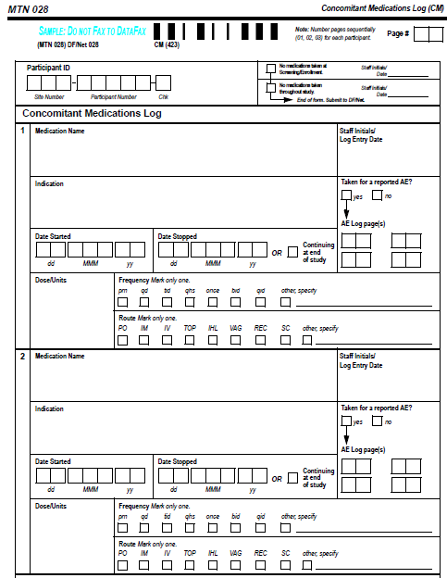
Concomitant Medications Log
(CM-1)

Slide 37
Concomitant Medications Log
(CM-1)
Document meds taken at the time of screening through termination date
Complete at Screening; update as needed through termination
Record trade name or generic name
For vaccines/injections, record separate entry for each dose
If exact dose/units not known, put best description possible
“Taken for AE” item will always be “no” for entries at Screening
Update PRE CRF if CM completion reveals conditions not already reported or observed
Notes:
The Concomitant Medications Log is started at the Screening Visit.
If the exact dose or unit is not available or known, put best description possible. For example, put ‘2 small green pills’ – anything is better than nothing or n/a.

Slide 38
Eligibility Criteria (ECI-1)
Allows SCHARP to report on # ppts screened, # enrolled, # screen fails and reasons for screen fails
Item 4: Mark all reasons that apply
In Screening Visit packet; complete only if screen fail
Move to Enrollment Visit packet and complete then if Enrollment scheduled
If a participant screen fails, then screens again:
  Always update and re-fax original ECI completed for the participant - do not complete a 2nd (new) ECI CRF
Notes:
The Eligibility Criteria CRF will allow SCHARP to report on the number of people screened for 027, the number of participants enrolled, the number of screen fails and the reasons for these screen fails
This form is included in the Screening Visit form packet and should be completed at Screening and faxed to DataFax only if the participant will not be enrolled for whatever reason.
Lastly, if the participant is eligible and wants to enroll, this form should be moved to the Enrollment Visit form packet and completed at the Enrollment Visit.

Slide 39
Screening Visit QA/QC
Before ppt leaves:
  Review visit checklist for completeness
  Review screening eligibility checklist/worksheets for completeness
Make sure lab requisition documents are in order
Review pelvic exam/physical exam forms and make sure all needed items are entered on PRE log
Do not fax any forms until ppt enrolls; fax ECI if ppt will not proceed to Enrollment
Make sure systems are in place for enrollment, including scheduling, ppt files, Pharmacy is aware of potential enrollment, etc.

Slide 40
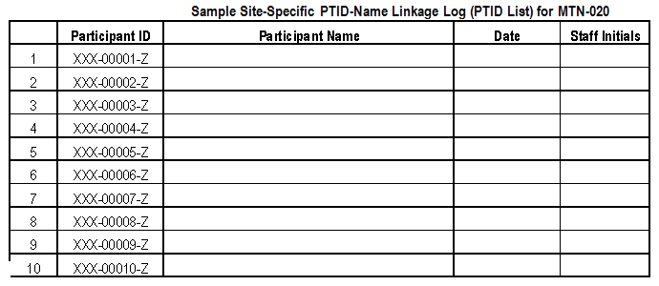
PTID Name Linkage Log
MTN-028
Notes:
SCHARP provides a hard copy of the PTID Name Link Log, listing ppt identification numbers for MTN-028. Information on how to complete this log is in your site’s DM SOP. Again, PTIDs are assigned only to those prospective ppts who complete SCR IC, regardless of whether they enroll in the study. Ppts keep the same PTID even if undergoing mult. screening attempts. These logs have been emailed to the site study coordinator.
PTID Name Linkage Logs always are stored in a double-locked area to protect ppt confidentiality and should be kept separate from ppt binders
Use only 1 PTID per participant, regardless of screening attempt.
Discussion Question: who will be responsible for completing this log at your site?

Slide 41


